Slide 1
COMMONLY-UTILIZED STATISTICAL METHODS IN SLEEP MEDICINE FOR ESTABLISHING ASSOCIATION OR CAUSALITY
Sept 2, 2022
Discussants
Brian Locke MD
Krishna M. Sundar MD
Notes:
Cross sectional teaching points:
Structure of argument
Causal inference idea: discuss this - Counterfactuals and average treatment effect - https://twitter.com/nytopinion/status/1454801591127707650?s=12
Causal inference reasources: https://twitter.com/WomenInStat/status/1443518855633059845?s=20
Estimand: A conceptual target that you are trying to estimate.
Estimator: The machinery for getting to your estimate.
Estimate: Just a number. Has no properties or anything.
Confounding / regression [ ] expand this – for example, the idea of how strong the confounders might be in comparison to the effect being investigated (nutritional epidemiology)
Relationship of manipulating a confounder https://twitter.com/nickmmark/status/1453883562185281536?s=20
Immortal time(?) [ ] important -
Immortal time bias? https://www.atsjournals.org/doi/epdf/10.1164/rccm.202207-1301LE
Exposure assessment? [ ] expand this
Confounding by indication. [ ] expand this
Intervention teaching points:
Power [x]
Outcomes [x] – discussed as HR.Maybe de-emphasize this
[ ] changes to make:
-→ introduce DAGs for more discussion of confounders.
This might actually be agood frame for the entire presentation
→ Draw a simple DAG for one paper. Use collider bias as a reason / explanation of berkson’s bias
Remove the hazard ratio teaching point and replace with the group assignment slide or similar
Potential Goals
Understand the difference between RR, OR, and HR (and dichotomous vs time-to-event outcomes)
Understand the relationship between study size, effect size, and power.
Understand challenges to quantifying the “exposure” to OSA and how that influences the ability of studies to show the effects of untreated OSA over decades
Understand the limitations of cross-sectional and cohort studies in assessing causation
Understand what a multivariable regression is.
Understand what assumptions need to be true for “independently associated” to represent a causal effect in a study using a regression analysis

Slide 2
Understanding sleep in relation to outcomes
Sleep as a behavior which unlike others occupies a finite portion of our lifetime
Alterations in behavior – measured through different metrics – relation to long term outcomes
New era of assessing relationships using statistical techniques (evolved since the Framingham heart study)
Problem with sleep
Measurement duration confined to one night (or 1-4 weeks)
Lack of sleep-derived biomarker (similar to HbA1C for DM) that can be used to assess sleep deprivation or degree of hypoxemia to long-term outcomes

Slide 3
Goals:
Understand that the disjunctive syllogism is the structure of a scientific argument
Know the limitations of a cross-sectional design as compared to cohort as compared to randomized trial viz-a-viz causal inference
Understand what a hazard ratio is and why they are so common in medical research
Know the determinants of a studies power.

Slide 4
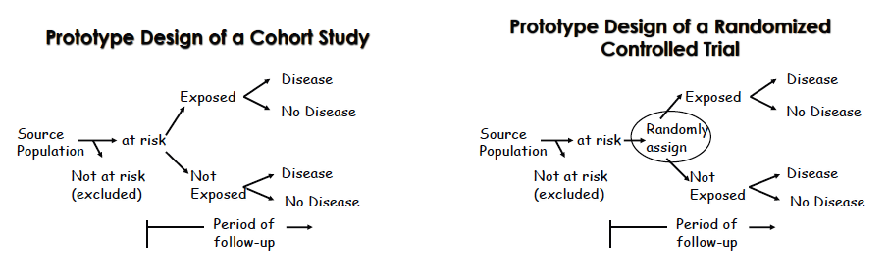
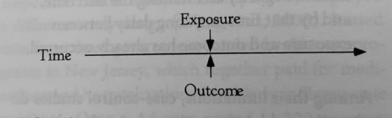
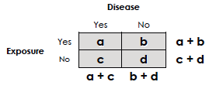
Imagine it’s 1950. You discover that OSA is very common. How do you figure out if it matters?
Proto-prototype of a Cross-sectional Study
Notes:
Case control is the other major option, but isn’t needed in sleep medicine all that much because the advantage of the design is it’s efficient for rare diseases or outcomes (sleep common) while the challenge is in properly matching cases to controls, which is particularly hard in sleep. (exposure assessment is also hard, as perception of sleep are unreliable).

Slide 5
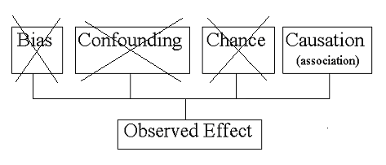
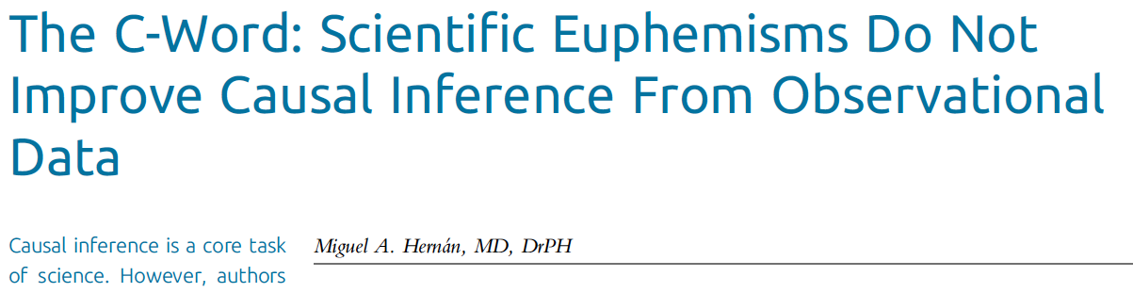
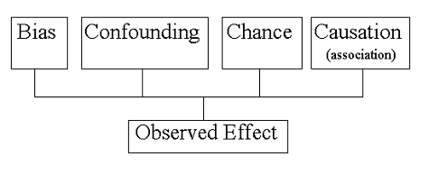
Structure of Observational Study ‘Argument’: Disjunctive Syllogism
If correlation isn’t causation.. Then what is it?
???
Notes:
Greg Stoddard Biostats Manual

Slide 6

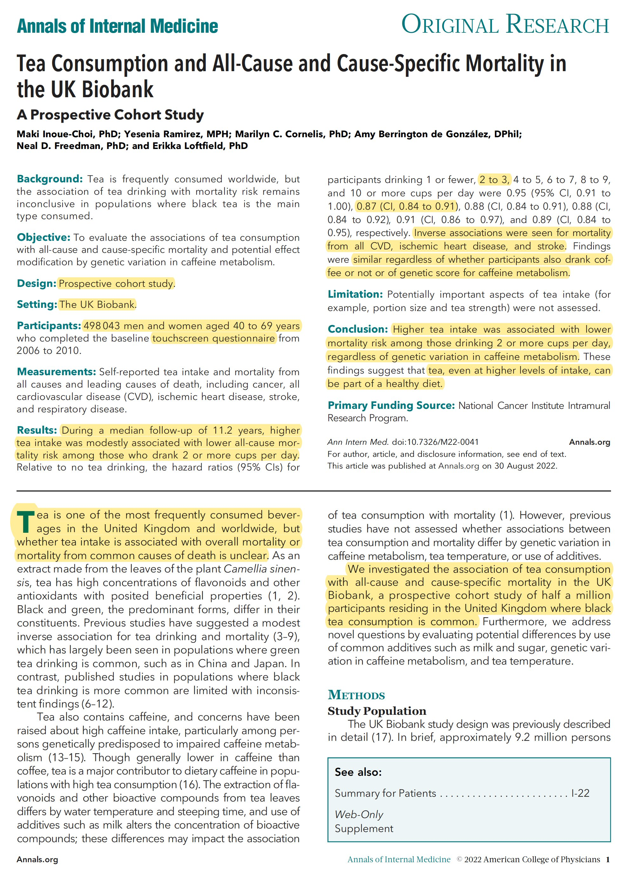
Causal Inference
What is the question?
Mortality(Tea=1) vs Morality(Tea=0)
Mortality{Do(Tea=1)} vs Morality{Do(Tea=0)}
The Fundamental Problem of
Causal Inference
Robert Frost (Maayan Harel)

Slide 7
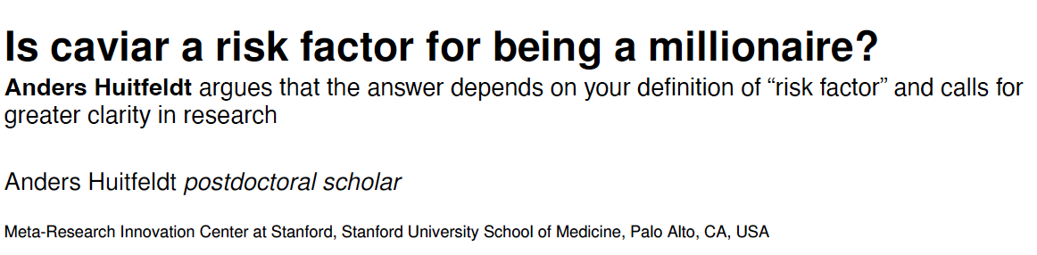
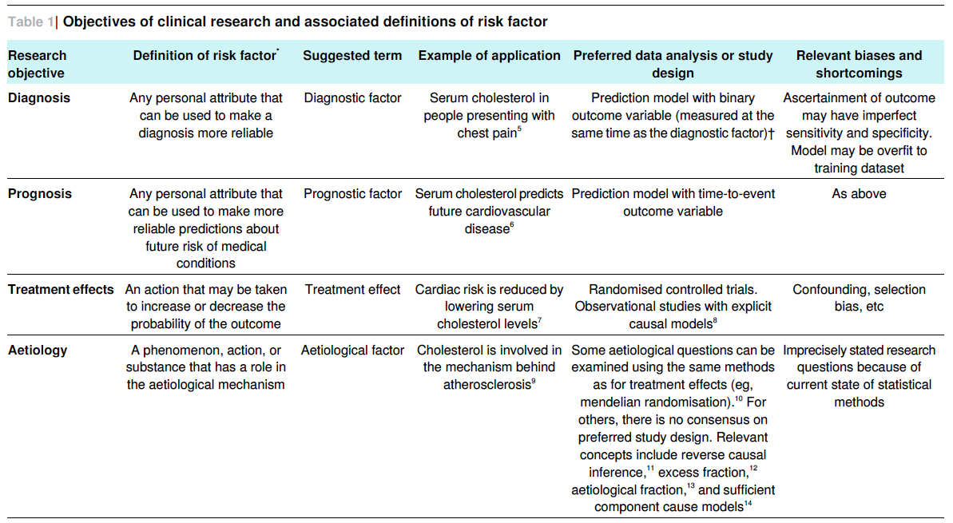
In OSA, what are we we interested in?
Consider central sleep apnea in CHF

Slide 8
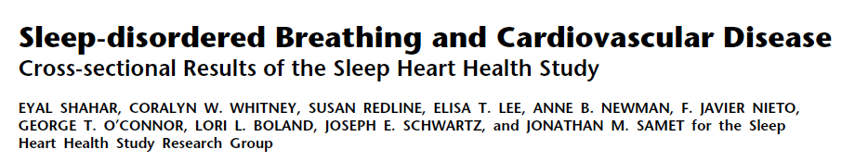

Slide 9
Sleep-disordered Breathing and Cardiovascular Disease Cross-sectional Results of the Sleep Heart Health Study
Design: Retrospective Cohort Cross-sectional
Population: Sleep Heart Health (1995-98), n=6424 (-1200 missing data)
Exposed/Unexposed: AHI quartile (0-1.3, 1.4-4.4, 4.5-11.0, 11+)
Also, Sleep hypoxemia and arousal index
Outcome: Prevalent odds of CVD (why not incident?)
Statistics: Logistic regression with possible confounders
Findings: Quartile III and IV of AHI and %Hypoxemia indepdently associated with prevalent CVD (particularly HF and Stroke).
Notes:
Representative cohort
All had home sleep studies (with addition of some EEG by the sounds of it.
Interviewed patients about previously diagnosed conditions

Slide 10
Statistical Teaching point:
Ascertainment of exposure status
Is “Have you ever been diagnosed with OSA?” accurate? (e.g. NHANES)
How would you expect the group assignment to change if PSG was used?
If you could design a ideal categorization of the groups, what would it be?
How would this effect the study conclusions?
Notes:
Many – if not majority – not diagnosed
True if survey or PSG used - Need screening on everyone to accurately classify
Two groups are more similar to each-other than not

Slide 11
Cross-sectional vs Retrospective Cohort
Cross-sectional study: exposure and outcome assess simultaneously
Cohort study: exposure assessed before outcome
Can only investigate prevalence of disease
Pros: easy, reliable if exposure doesn’t change (eg genetics), or prior exposure hard to remember (eg diet)
Cons: can’t determine direction of causality, current exposure=surrogate for past exposure, overrepresent longer duration cases.

Slide 12
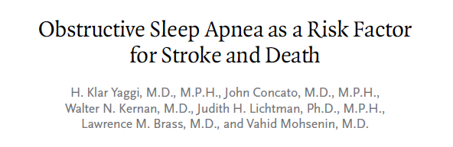

Slide 13
Obstructive Sleep Apnea as a Risk Factor for Stroke and Death
Design: Prospective cohort (clinical)
Population: W/o pre-existing CVD referred for SDB eval @ Yale. 1997-2000, n=1022
Exposed: Referred to clinic, AHI > 5 events/hr
Unexposed: Referred to clinic, AHI < 5 events/hr
Outcome: incident stroke or death, median follow-up 3.4 yr
Statistics: Cox-regression~=Kaplan Meier/Log rank/proportional hazard
Findings: OSA associated with HR 1.97 for stroke or death after adjusting for confounders

Slide 14
Community vs Clinical Cohort
Population of interest
Community comparison:
(C+D) vs A
Clinical comparison:
C vs B
Any factor that changes the likelihood of B+C is a potential confounder
If, rather than population burden, you are interested in how to care for B+C, this may be the correct method
Seeks care
A
B
Has OSA
C
D

Slide 15
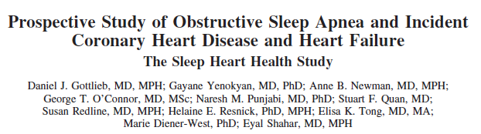

Slide 16
Prospective Study of Obstructive Sleep Apnea and Incident Coronary Heart Disease and Heart Failure The Sleep Heart Health Study
Design: Prospective cohort (community)
Population: Sleep Heart Health (1995-98), n=6441 (-2000 excluded))
Exposed: Mild (5-15), Moderate(15-30), Severe (30+) OSA by AHI. Mostly untreated (2.1% overall, 8.4% w mod-sev OSA treated)
Unexposed: AHI < 5 events/hr
Outcome: incident CHD before 4/1/06 (~8.7y)
Statistics: Cox-regression (HR)
Findings: More severe OSA independently associate with incident CHD (particularly CHF) in men, not women.
Notes:
Models are presented that adjusted
for the following: (1) Age, race, BMI, and smoking status (with
indicator variables for current and former smoking); (2) these
variables plus total and HDL cholesterol and diabetes mellitus,
which are causes of cardiovascular disease for which the causal
relation to OSA is uncertain; and (3) these variables plus hypertension hypertension
(systolic blood pressure, diastolic blood pressure, and use of
antihypertensive medications), which has been hypothesized to lie on
the causal pathway between OSA and cardiovascular disease

Slide 17
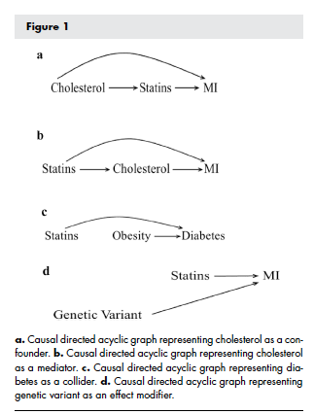
Confounders, Regressions
Regression: estimate effect with “all other things held equal”.
How do you decide what things to include?
Confounders
Mediators?
Colliders?
Is your understanding of what factors matter correct?
Can you measure everything you want to measure?

Slide 18
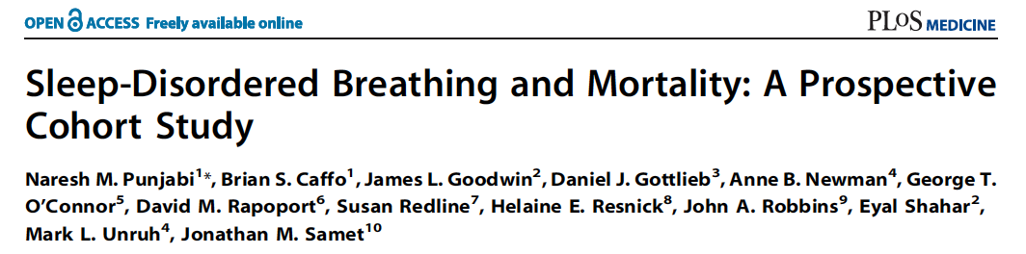

Slide 19
Sleep-Disordered Breathing and Mortality: A Prospective Cohort Study
Design: Prospective cohort (community)
Population: Sleep Heart Health (1995-98), n=6441 (-147 excluded d/t OSA treatment)
Exposed: Mild (5-15), Moderate(15-30), Severe (30+) OSA by AHI. Mostly untreated (2.1% overall, 8.4% w mod-sev OSA treated)
Unexposed: AHI < 5 events/hr
Outcome: (incident) death w/ ~8.2y avg follow-up
Statistics: Cox-regression (HR)
Findings: Mod-severe OSA (men) and severe OSA (women) associated with increased hazard of mortality. No relationship if age 70+
Notes:
“Briefly,
between 1995 and 1998 participants were recruited from
prospective cohort studies including the Framingham Offspring
and Omni Study, the Atherosclerosis Risk in Communities Study,
the Cardiovascular Health Study, the Strong Heart Study, and the
cohort studies of respiratory disease in Tucson and of hypertension
in New York. Eligible individuals were at least 40 years of age and
were not being treated for sleep-disordered breathing with positive
airway pressure, oral appliance, oxygen, or tracheostomy
”

Slide 20
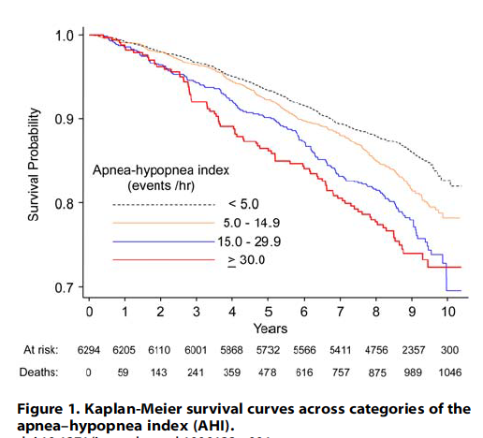
What is a Hazard Ratio / KM / Cox-regression? We’re all dead in the long run
2 versions of Russian Roulette
X: 1:6 w/ bullet, Y: 1:4 w/ bullet
HR = (1/6) / (1/4) = 0.67
1000 people play 11 rounds of each
On round
P(Surviving 10 rounds?)
X: (5/6)^10 = 16% -> 160 survivors
Y: (3/4)^10 = 5.6% -> 56 survivors
RR would be 84% / 94.6% = 0.88
Round 11: X = 27 die, Y = 14 die yet HR higher in group Y!
What if Group Y says screw it after 7 rounds, but we want to maximize our data?
HR allows for “censoring of data”

Slide 21
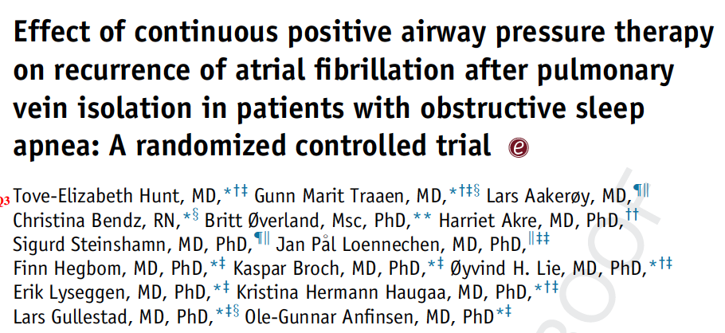

Slide 22
Effect of continuous positive airway pressure therapy on recurrence of atrial fibrillation after pulmonary vein isolation in patients with obstructive sleep apnea: A randomized controlled trial
Design: Open-label RCT (A3 study, Oslo)
Population: new dx AHI 15+, ESS < 15 (etc), undergoing CA-PVI for Afib and able to tolerate CPAP during run-in period
Exposed: randomized to auto-CPAP
Unexposed: randomized to no CPAP
Outcome: 2+min Afib months 3-12 after CA-PVI by loop recorder
Statistics: logistic-regression*** yes/no recurrence
Findings: Mod-severe OSA (men) and severe OSA (women) associated with increased hazard of mortality. No relationship if age 70+

Slide 23
Negative RCT after positive observational study? power, adherence, & confounding
 | Disease+ Hypothesis+ | Disease- Hypothesis-
Test+ Study+ | TP | FP | PPV: TP / T+
Test – Study+ | FN | TN | NPV: TN / T-
 | Se: TP / D+ Power: Se | Sp: TN / D- Alpha: 1-Sp
?
Power ~ Sample size/$$$, Alpha, minimally important absolute effect size*, info per data point (Continuous > HR > dichotomous), non-adherence/loss f/u
Notes:
Observational studies have suggested that CPAP treatment of
OSA may reduce the AF recurrence rate by 25%–50%,7,9
which is considered a clinically meaningful reduction. We
expected AF to recur in 70% of the patients in the standard
care group. To prove a 50% reduction of AF recurrence in
the CPAP group with a power of 80% and a significance level
of 5%, we would need 28 patients in each group, or 56 in total.
We included 109 patients to allow for dropouts
*Compared to the amount of variability in the outcome.

Slide 24
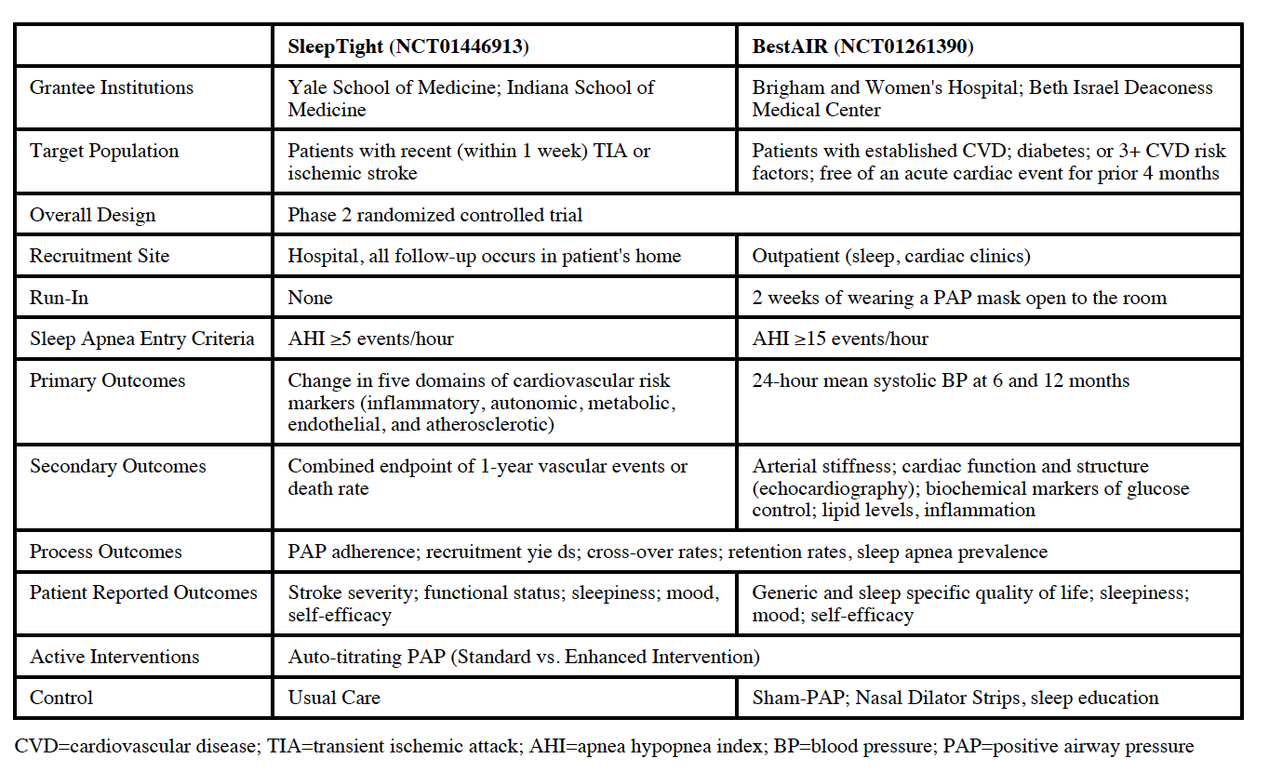
Notes:
Sleep tight: RCT to evaluate CPAP post TIA/CVA
Randomize to: CPAP vs CPAP w behavioral intervention+support
Outcome: change in parameters hypothesized to mediate stroke risk (surrogate outcomes)
BestAIR: measure 24h-BP and other surrogate/process measure outcomes. Mod-sev OSA, run-in w mask. RCT to: med therapy (CMT), CMT+sham CPAP, CMT+real CPAP, CMT+real CPAP&behavior

Slide 25
Why do phase 2 trials: Why surrogates? Why process measures?
Power ~ Sample size/$$$, Alpha, minimally important absolute effect size, info per data point (Continuous > HR > dichotomous), non-adherence/loss f/u
Need to estimate each of the above parameters
Surrogates: Chosen to show a larger effect size = smaller trial
Validity depends on them correlating with the outcome of interest
Do NOT trust a positive clinical-outcome on a phase 2 trial powered to find a difference in a surrogate: increased error rates (Type 1 and 2)

Slide 26
Goals:
Understand that the disjunctive syllogism is the structure of a scientific argument
Know the limitations of a cross-sectional design as compared to cohort as compared to randomized trial viz-a-viz causal inference
Understand what a hazard ratio is and why they are so common in medical research
Know the determinants of a studies power.
Notes:
Other really important issues we didn’t get to discuss:
- Immortal time bias: ubiquitous in observational research and much harder to correct than biases

